Slide 1

Requirement for Customer Whitelist Menu
Rajesh paudel
2021.11.23

Slide 2
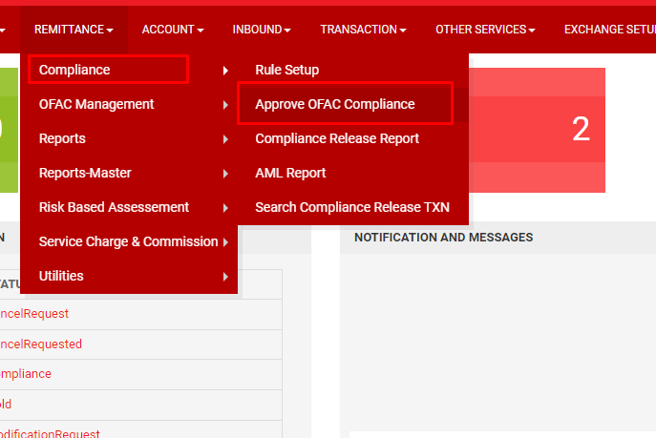
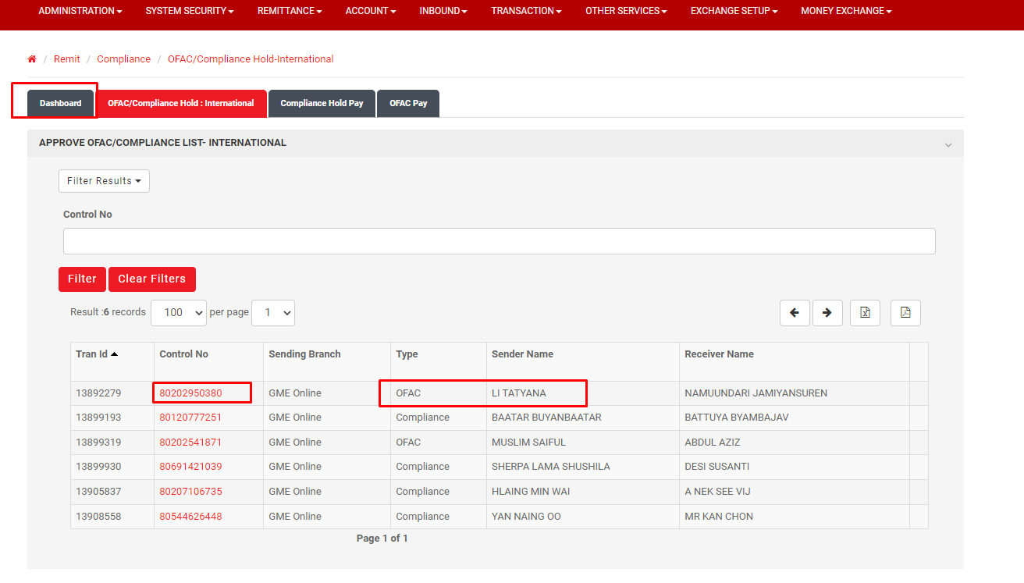
1.Admin System menu
Admin Menu> Remittance>> Compliance>>Approve OFAC compliance
Click Control No, go to compliance or OFAC hold transaction Type.

Slide 3
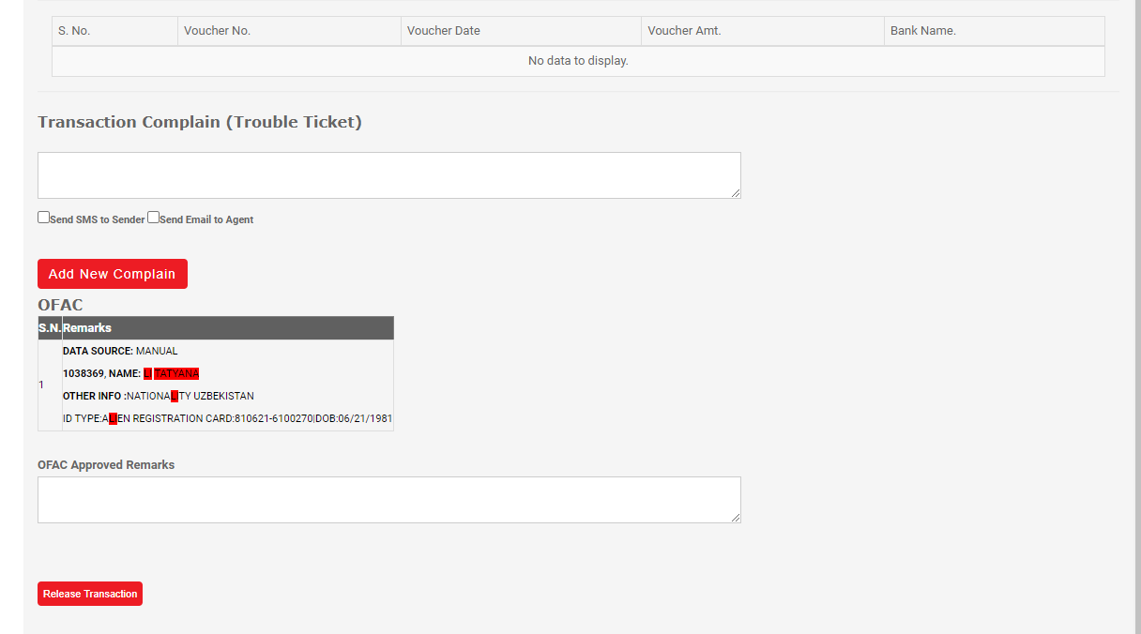
Click on Whitelist customer menu both for OFAC Hold and Compliance Hold Transaction.
Whitelist Customer

Slide 4
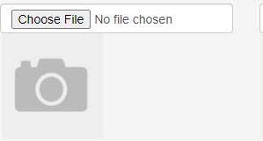
case
Info required to whitelist customer
Whitelist Customer
Allow admin to select the list from dropdown menu for Family details, source of fund, Nationality, Customer Occupation field and fill all the necessary information which was included.
.
Sender/Receiver
customerId/ReceiverId
123456
RelationShip
Source of Fund
Nationality
Date of Birth
Customer occupation
Salary Statement
Id Type
Id Number
Customer Id card
Contact No
Place of Birth
Country of birth
Expiration Date
Whitelist Customer
Notes:
Family Details: Relationship dropdown menu
Mandatory Field:
- Sender/Receiver
- Source of Fund
- Nationality
- Date of Birth
- Id Type
- Id Number
- Contact No
- Place of Birth
- Country of Birth
- Expiration Date

Slide 5
Menu Required
Note:
Make all field mandatory to fill up
Whitelist customer
If sender
Date of birth and mobile no should be matched,
If beneficiary
Nationality and mobile no should be matched.
Menu required in Admin system
->Whitelisted customer list-> show customer list which was whitelisted including details, customer name, wallet number, country name and contact number.
->Compliance released transaction list- show compliance auto released transaction list with remarks reason for whitelisted customer for compliance reporting purpose.

Slide 6

THANK YOU
2

